Slide 1
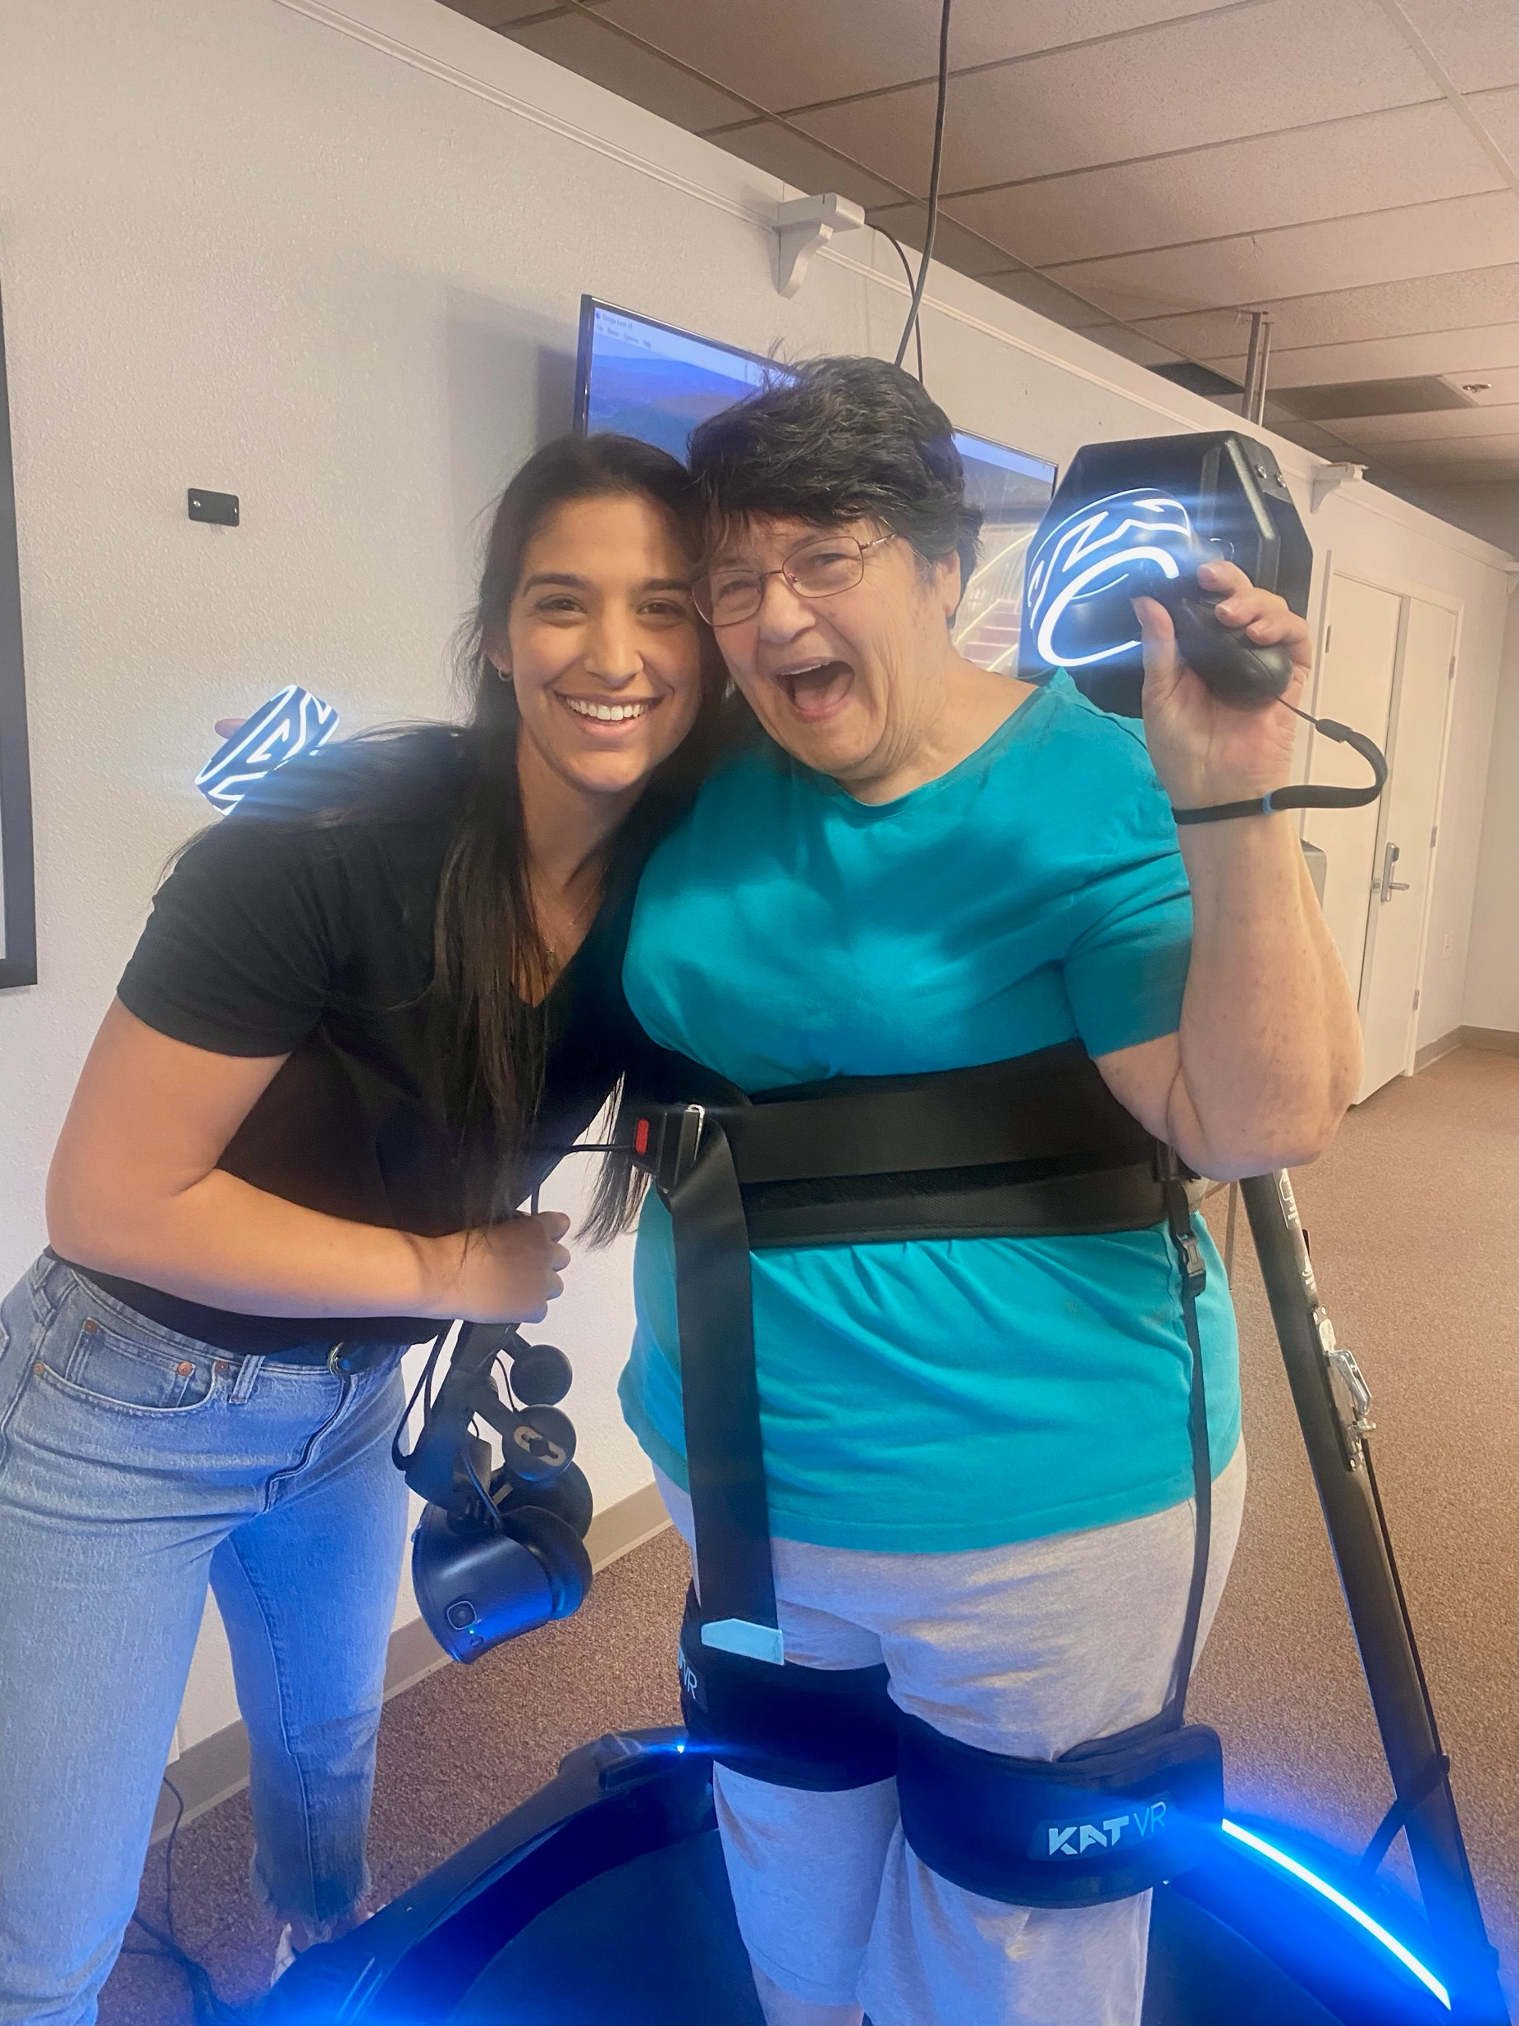
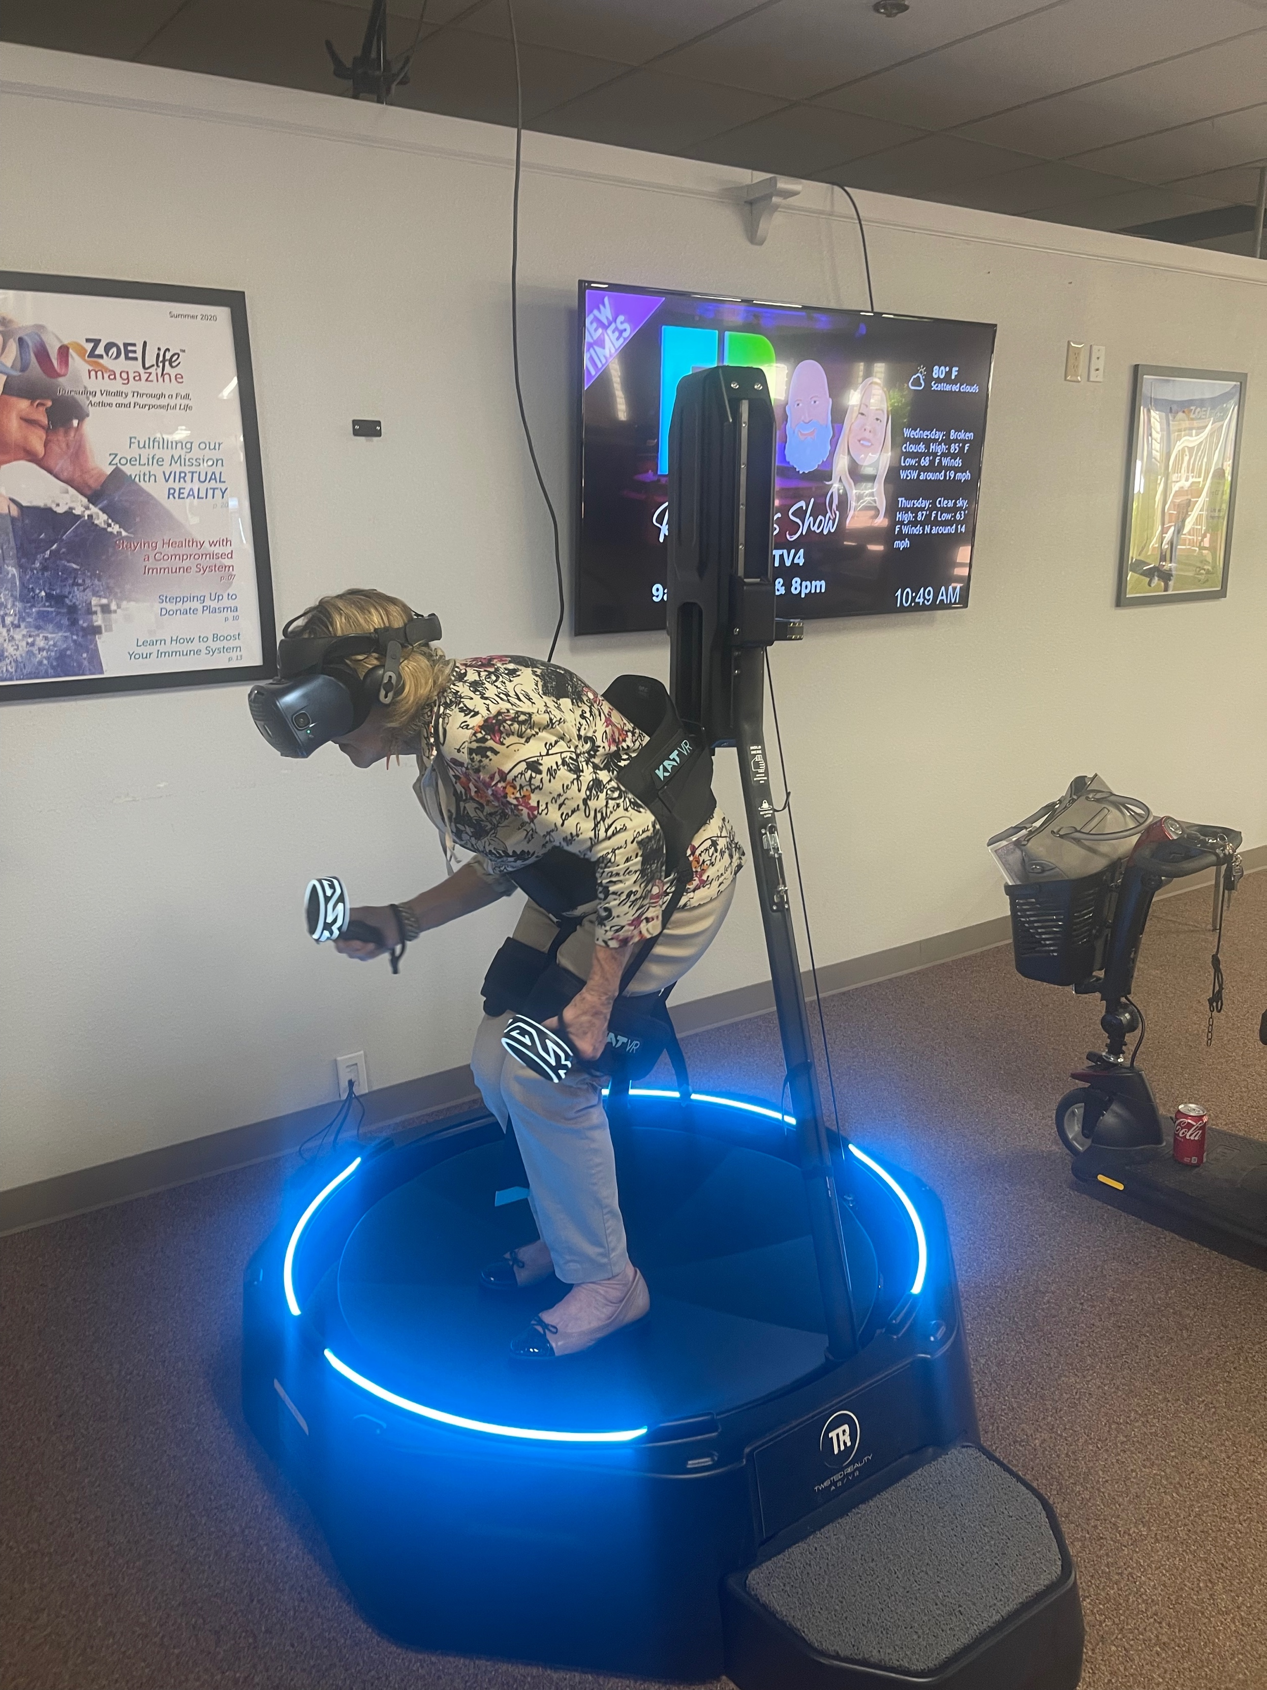
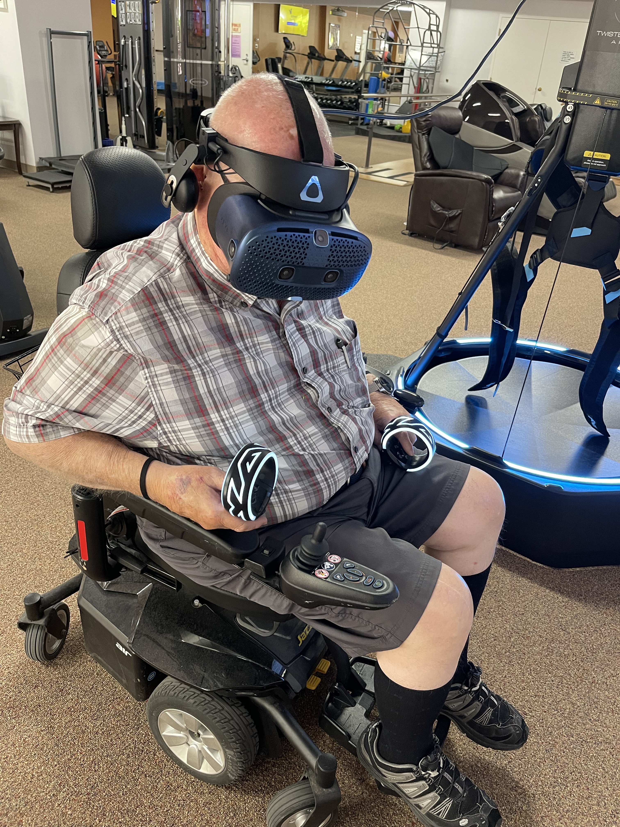
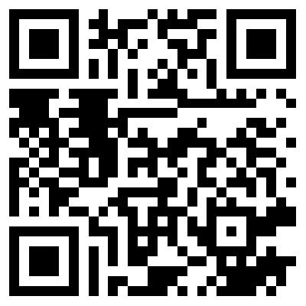
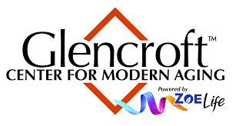
Implications of Virtual Reality Technology on Aging and Fear of Falling
Malia Menon, OTDS
Huntington University Doctor of Occupational Therapy Program
Project Description & Sites
Project Completion and Outcomes
Areas of Study: (1) Program Development (2) Research
Population: Older Adult Population
Site: Glencroft Center for Modern Aging
Description: My doctoral capstone project focused on the implications virtual reality (VR) technology has on aging and fear of falling. Through program development I provided occupation-based strategies and instruction on how to reduce falls and increase occupational performance. I also conducted research to assess how VR technology could be used as an intervention to reduce fear of falling within the aging population.
Outcome Measure 1: Through program and policy development/enhancement in a long-term care facility the student will aim to enhance occupation-based strategies for improving I/ADL engagement amongst the target populations as measured through survey and quality of life indicators.
Outcome Measure 2: In order to develop an increased application of research skills, the student will develop a survey that assesses fear of falling within the older Adult Population.
Related Learning Objectives: Develop & conduct pre/post-survey research, present educational materials, create occupation-based VR tutorials
Mission & Vision Statements
Mission Statement: To increase physical, cognitive, and emotional quality of life in the older adult population using technology and occupation-based activities.
Vision Statement: To treat the older adult population holistically by allowing them to safely participate in desired meaningful activities while simultaneously improving physical and cognitive functioning.
Deliverables
Future Implications for OT
Deliverable #1: Virtual Reality Tutorials
Deliverable #2: CEU Course
Deliverable #3: Presentation
Deliverable #4: Flyer and Data
Deliverable #5: Pre/Posttest Survey
Impact on OT
Research showed reduced fear of falling after VR intervention, recorded presentation on the implications of VR technology on aging, research manuscript outlining the results of my research
Impact on my career
I was able to further develop my knowledge on age related impairments and how virtual reality technology can be utilized within the ageing population. My doctoral capstone challenged me to think outside of the box to help the populations I serve which I plan to continue to do throughout my career.
Needs Assessment | Literature Review
Needs Assessment: I reviewed the literature and consulted with other occupational therapists and professionals to assess the need for further research on the implications of virtual reality on falling. I also consulted with my capstone site to assess the need for further program development of their virtual reality program for older adults.
Literature Review:
Using VR technology has shown benefits in treating age related conditions including Parkinson’s Disease, stroke related impairments, decreased functional mobility, and cognition.
1 in 4 older adults experience at least one fall a year
20-60% of older adults report a fear of falling and 20-55% report decreased activity due to this concern
Current literature supports that VR has the potential to be utilized as conjunctive treatment and produce better outcomes in the aging population
Further research with standardized protocols are needed to further generalize results and expand on the benefits of VR technology
Christ | Scholarship | Service
Christ
Leviticus 19:32 – Stand up in the presence of the elderly, and show respect for the aged
Service
Caring for and serving the older adult population
Scholarship
Research and Program Enhancement
KEY REFERENCES
*Full reference list and image reference list available upon request

